Slide 1
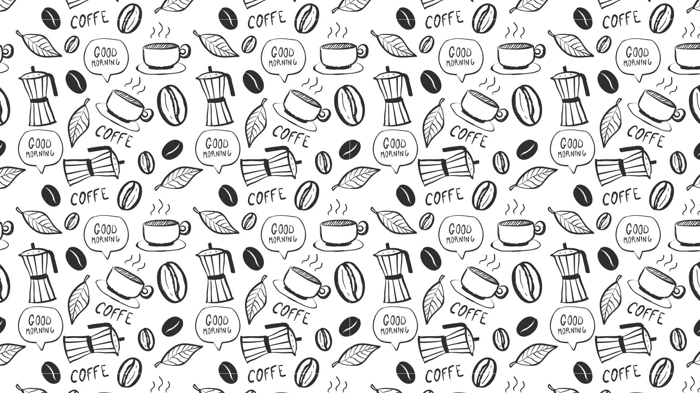

Slide 1
Coffee Chain Profitability Analysis
Cole Phillips
Dr. Hugh Watson

Slide 2


Slide 5
Why Is Coffee Chain Not Profiting?
Products & Location
Inventory Management
Marketing Expenses
Notes:
This is an analysis of why Coffee Chain is not profiting. We will look into issues occurring from different regions of the United States and figure out why they have not been profitable. The main 3 issues to Coffee Chain’s profitability are products/location, inventory management, and marketing expenses. We will explore how these are contributing to their profit loss and what they can do to increase profits.

Slide 3
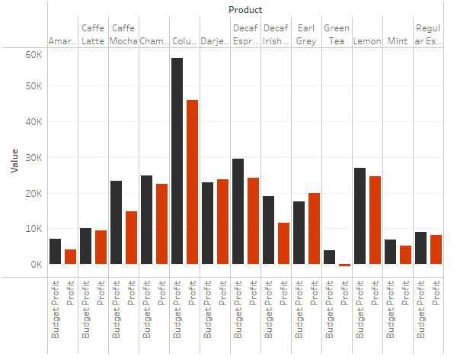
Budget Profit vs Profit
Observations:
The budget profit exceeds each product’s product besides Earl Grey and Darjeeling
Least Profitable: Green Tea, Amaretto, Mint, & Regular Expresso
Green Tea is below 0
Notes:
To begin the analysis, we start by observing the amount Coffee Chain budget for profit and how much they are actually making in profit. This graph shows that for each product they have, Coffee Chain is overbudgeting for each product besides earl grey and darjeeling. We can see that green tea, amaretto, mint, and regular expresso are the least profitable products on the graph. Green tea is the only product is the only product that is below 0.

Slide 4
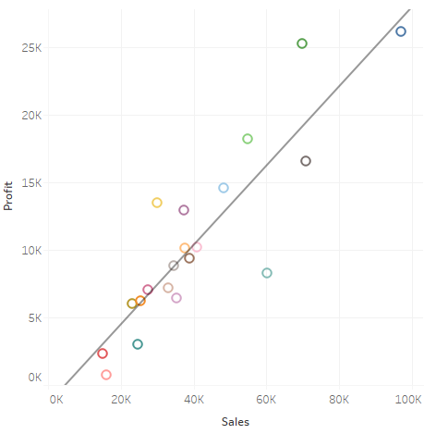
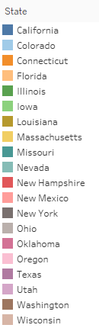

Profit over Sales by State
Observations:
As sales increase profit increases
Points underneath the line indicate there is less profit than expected.
If the point is beneath the line, but the sales are high then there is a big profit loss
California, New York, and Nevada are points of concern
Notes:
This graph tells us how much profit each state can expect to make as sales increase. The r-squared value, .77818 > .5, meaning there is a strong correlation between sales and profit. The P-Value, <.0001, indicates that there is a 1 in 1000 chance the information in the graph occurred by chance, meaning this is a reliable graph. The marks above the trend line indicate that we are gaining more profit than expecting. For the marks underneath the trend line, if they have high sales, we can expect those points to be mostly responsible for the company’s loss in profits. By this logic we should see that Nevada, California, and New York will make up a bulk of the company’s profitability problem.

Slide 5
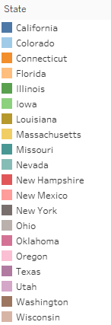
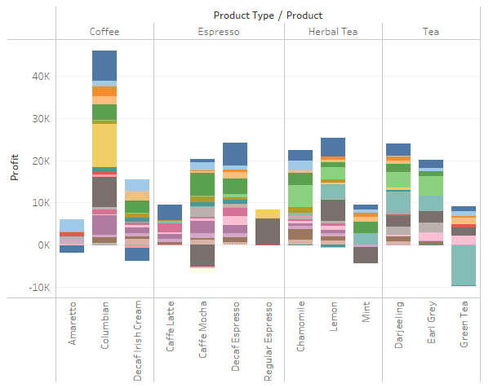
Product Profitability by State
Observations:
Amaretto and decaf Irish cream are not profitable in California (
Caffe mocha and mint are not profitable in New York
Green tea is not profitable in Nevada
Most of the other products produced profits in each state
Notes:
In this graph, we can confirm that Nevada, New York, and California make up a bulk of the profitability issues. The graph breaks down the profit of each product in all the states. Green tea’s profitability in Nevada in in the below 0 and makes up majority of the profit loss for that product. New York is the main reason for profitability loss for caffe mocha and mint. Lastly, California makes up the profitability issues for decaf Irish cream and amaretto.

Slide 6
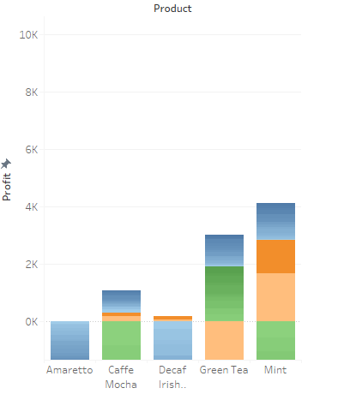
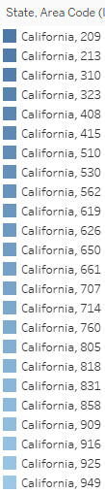
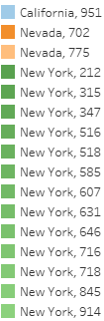
Product Profitability by Area Code
Observations:
Amaretto is not profitable in any of the California area codes
Caffe mocha and mint are not profitable in any of the New York area codes
Green Tea is not profitable in Nevada
The drink products are profitable in each of the other states they are sold
Notes:
As we take a deeper look into product profitability, we can see the area codes where certain products are not profitable. In every California area code, Amaretto and decaf Irish cream fail to make any profits, so it is recommended to discontinue the product in California. In every area code in New York, caffe mocha and mint are not profitable so they should be considered for discontinuation. Green tea should be discontinued as well in Nevada since it is also not profitable. To figure out why these products are not profitable, we need to look at some more variables such as inventory and marketing expenses.

Slide 7
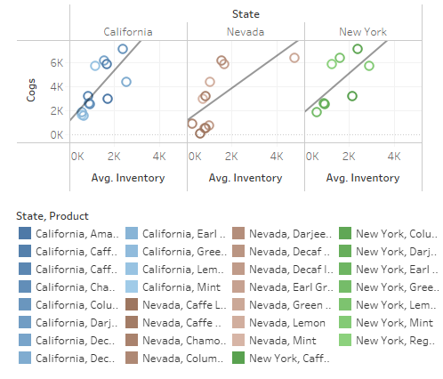
Inventory Turnover by State
California Trend Line Equation
Nevada Trend Line Equation
New York Trend Line Equation
Notes:
In this graph, the inventory turnover ratio is found calculating the COGS over the average inventory. The inventory turnover ratio is a measure of how many times inventory is sold and replaced over a given period. A higher inventory turnover means that the company is selling goods quickly and that there is considerable demand for the products. The trend line equations tell us the average inventory rate for each state (2.11491 for California, 1.35204 for Nevada, and 1.6257 for New York). These are relatively bad inventory turnover rates and a reason for this is because of the large amounts of inventory for the wrong products. These products being the California’s amaretto and decaf Irish cream, New York’s caffe mocha and mint, and Nevada’s green tea.

Slide 8
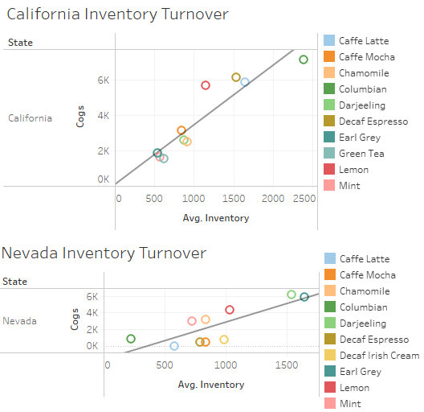
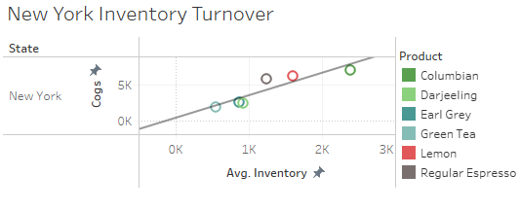
New Inventory Turnover by State
New California Trend Line Equation
New Nevada Trend Line Equation
New New York Trend Line Equation
Notes:
This is the new inventory turnover rate after removing California’s amaretto and decaf Irish cream, New York’s caffe mocha and mint, and Nevada’s green tea. The new inventory turnover rate jumps to 3.36625 in California, 4.41857 in Nevada, and 3.17449 in New York. These increases in inventory turnover rates indicate that by eliminating the products previously mentioned, Coffee Chain can be keep a balance between their sales and inventory while still being profitable.

Slide 9
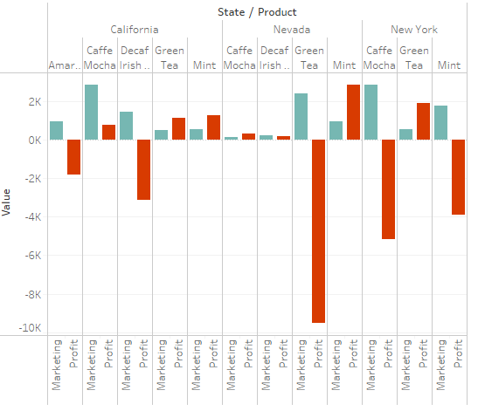
Marketing Expenses
Observations:
California’s amaretto and decaf Irish Cream profits are negative even with marketing
Nevada’s green tea profits are extremely negative despite marketing
New York’s mint profit is negative despite marketing
These should be removed from the menu due to poor sales performance
Notes:
Lastly, Coffee Chain is spending too much money on California’s amaretto and decaf Irish cream, New York’s caffe mocha and mint, and Nevada’s green tea. These products are not profitable when the company spends money for marketing on them.

Slide 10

Slide 6
Recommendations & Solutions
California’s amaretto and decaf Irish cream, New York’s caffe mocha and mint, and Nevada’s green tea.
Put money into other products inventories since the ones previously mentioned do not benefit the company
Cut marketing expenses on the products mentioned and reallocate them to other products
Notes:
For Coffee Chain to start being profitable, they need to eliminate the majority of what is not making them gain any profits. After eliminating these products, the company will experience an increase in profitability and efficiency.

Slide 11

Slide 15
THANK YOU!
CONTACT US AT:
Cole Phillips
Ctp06592@uga.edu
678-910-7649

